Slide 1
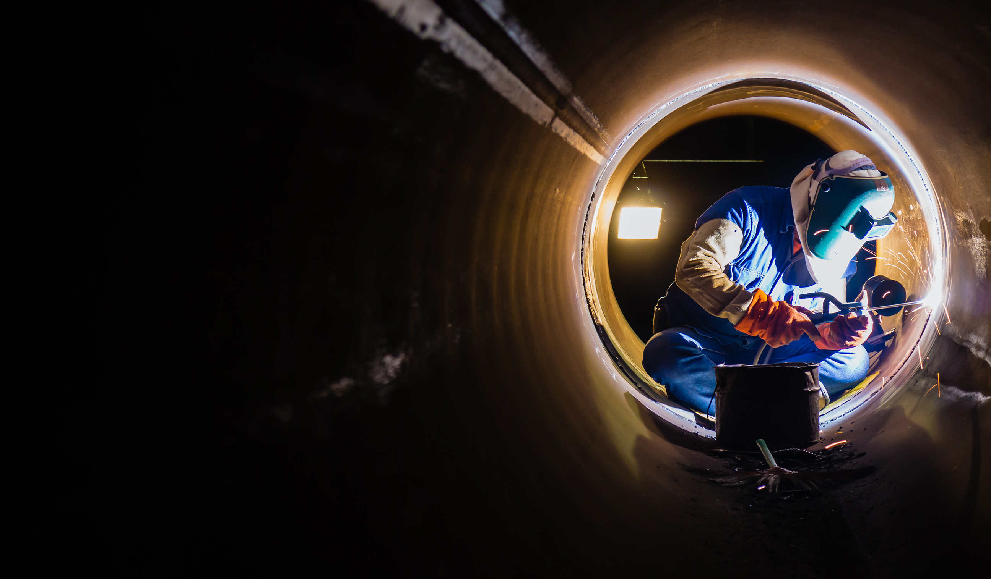


VIRTUAL REALITY WELDING TRAINING
CODED WELDER: OFO 651202-02
KM-05: GTAW/TIG PROCESS, NQF Level 3, Credits 3

Slide 2
ABOUT THIS MODULE
The main focus of the learning in this knowledge module is to build an understanding of GTAW welding processes as applied in the welding trade
The learning will enable learners to demonstrate an understanding of:
KM-05-KT01: General health, safety and environmental protection concepts GTAW (10 %)
KM-05-KT02: Principles of GTAW operation (30%)
KM-05-KT03: GTAW process variables (20%)
KM-05-KT04: GTAW process equipment and consumables (20%)
KM-05-KT05: GTAW electrodes classification and tip configuration (20%

Slide 3
KM-05-KT01: General health, safety and environmental protection concepts GTAW
Gas Tungsten Arc Welding (GTAW), involves fusing metals using a non-consumable tungsten electrode and an inert gas shield. Health, safety, and environmental protection are crucial considerations in GTAW.
Topic elements to be covered include
KT0101: Adherence to appropriate GTAW welding PPE
KT0201: Electric shock, harmful fumes and gases.

Slide 4
KT0101: Adherence to appropriate GTAW welding PPE
A revision discussion on the welding PEE
To adhere to appropriate CTAW welding, the welder must:
Wear protective clothing
Have all the mandatory equipment
Pay special attention fat overhead welding
Pay special protection for cutting operations

Slide 5
Eye Protection during Welding
Welders must use specialized welding goggles or helmets with tinted lenses to protect their eyes from heat, sparks, and bright light during welding, brazing, and cutting activities.
Caution for welders:
Never look at a welding arc or gas flame without wearing welding goggles or a helmet fitted with darkened lenses. Always wear safety glasses with side shields during chipping, grinding, or welding.
Many welding processes leave the weld covered with a thick coating called slag, which must be chipped or ground from the completed weld. Grinding is also sometimes needed to clean and prepare a piece of metal for welding. Special safety glasses should be worn.

Slide 6
Welders’ Clothing:
A revise of the welding PEE clothing:
Non-flame-resistant clothing can catch fire easily from sparks, flames, or molten metal.
Modern synthetic fabrics melt on contact with heat, potentially causing severe burns by sticking to the skin.
Flame-resistant clothing like wool or cotton is essential during welding to prevent burns from sparks, flames, or molten metal.
Long pants covering the ankles without rolled-up cuffs are recommended for added protection.
Clothing should have no open pockets to avoid catching sparks and hot metal, which can cause severe burns.

Slide 7
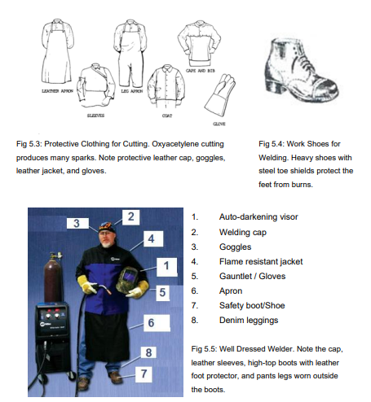
Welders’ Clothing (p3):

Slide 8
Other personal safety equipment (p2):
Helmets and hand-shields:
crucial for protection during welding due to the intense visible and invisible rays generated by arc welding, which can cause burns to the eyes and skin. It is essential to follow safety standards (ANSI Z49.1 and Z87.1) and take specific precautions:
ARC RAYS Protection:
Use an approved welding helmet with the correct shade of filter lenses to safeguard the face and eyes from arc rays and sparks.
Wear approved safety glasses with side shields underneath the welding helmet.
Helmet Features:
Welding helmets have an adjustable headband for easy raising and lowering.
The helmet can be raised for electrode positioning and lowered with a slight head movement before striking the arc.
Hand-shields:
Hand-shields are available for face protection but are typically used only for observation, as they require one hand to hold.
Lens Protection:
Outer lenses in welding helmets, made of shatterproof material, protect the inner lens but can become clouded and pitted from weld spatter.

Slide 9
Other personal safety equipment (p3):
Using Auto-darkening welding helmets
A technological advancement, enhance safety by eliminating manual visor adjustments, allowing welders to maintain visibility without removing the helmet, reducing the risk of accidents or injuries.
Advantages:
No need to use the hands to lift and lower the visor
No need to remove the helmet to see properly
Eliminates the risks of possible injuries.
Acts as a protective covering to the eyes and prevent it from exposure to irritating fumes and flying debris.

Slide 10
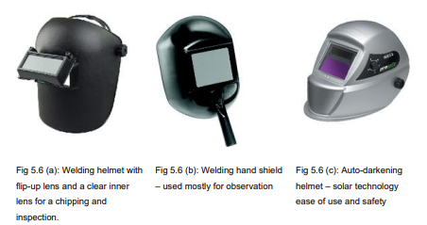
Examples of the different welding helmets:

Slide 11
Outer Clothing, Gloves, and Shoes
General safety precautions for welding clothing:
All arc welding clothing must be flame retardant, sturdy, and comfortable.
Clothing should lack pockets or cuffs that can catch sparks and molten metal.
Leather outer clothing is essential for most welding jobs.
Hand protection:
Leather gloves are always necessary.
Footwear recommendations:
Wear high-top boots that can be tucked under pants legs.
Caution: Use safety shoes with steel toe protection. Avoid welding in sneakers or sandals.
Maximum protection ensemble:
Full-length leather apron and a leather shoulder-and-sleeve garment.
Combined with leather gloves, safety shoes with protective spats, and safety glasses.
Provides necessary protection for any arc welding operations.

Slide 12
Welding Machine Safety
Various welding machines and accessories are available; adhere to manufacturers' safety guidelines for proper operation. General safety rules apply universally to all welding machines.
Caution: Protect yourself and others from possible serious injury or death. Keep children away. Pacemaker-wearers are to consult with a medical practitioner.

Slide 13
Key Welding machine safety rules:
Do not attempt to install or repair a welding machine yourself. Have a licensed electrician to do the job. Insufficient or improper wiring can ruin the machine and causes shock, burn, or fires.
Have a separate safety cut-off switch installed so that the welding machine can be completely disconnected from the AC line circuit.
Be sure the welding machine is properly earthed. Even though welding machines deliver low voltage, they can deliver a painful or even fatal shock. Remember: The earth clamp and lead do not earth the welding machine. The machine must have its own separate earth.
Use the proper size cable for the job. Check cables frequently and do not allow them to overheat.
Keep all electrical connections, cables, ground clamps, and electrode holders free from dirt, grease, or oil.
Never arc weld in a wet area. If you must work where it is wet, stand on a board or rubber mat. Do not lay welding cables in water. Suspend them overhead if possible.
Do not exceed the machine’s duty cycle. If a machine overheats, leave it running and allow it to cool down slowly.

Slide 14
Key Personal Safety Rules
Never look at a welding arc without proper eye protection.
Never weld or chip without safety glasses with side shields.
Wear the appropriate safety clothes for the job. Serious burns can result if you are not properly protected.
Attend to any injury promptly. Report injuries immediately and seek proper medical attention.
Make sure the welding area is properly always ventilated.

Slide 15
Key Procedural Safety rules:
Understand each step before attempting a procedure; if unsure, refrain from doing it. Knowing the job and potential safety hazards is crucial for procedural safety.
Avoid attaching an earth clamp or striking an arc near closed containers, those with flammable materials, gas cylinders, pipelines, or electrical wires.
Assume responsibility for others in the welding area; use temporary welding curtains if needed to shield them from arcs or sparks.
Clamp weldments securely to metal welding tables or fixtures to prevent falling during welding or cutting.
Regularly inspect welding equipment for damage; replace worn or broken parts promptly. In case of electrical shock, shut down equipment, report the issue, and seek repairs.
Keep the work area clean and organized.
Properly shut down all equipment before leaving the work area.

Slide 16
Assessment Activity
List the various items of PPE typically used by welders from 1 – 8 by referring to figure attached.
Briefly describe FIVE safety precautions when using a welding machine? All answers must refer to the welding machine.
List THREE advantages for using an auto-darkening helmet instead of the traditional flip up-down helmet
List THREE safety rules for each
Welding machine safety
Personal safety
Procedural Safety

Slide 17
KT0102 Electric shock, harmful fumes, and gases
Welding poses various safety risks, including electric shock and exposure to harmful fumes and gases. Proper precautions and protective measures must be taken to ensure the safety of welders and those in the vicinity.

Slide 18
KT0102 (a) Welding Hazards
In welding shops, the constant risk of fire exists due to sparks and molten metal.
Fire extinguishers for all fire types should be available, with welders knowing their location and proper usage. Regular maintenance is crucial to ensure extinguishers are fully charged.
Caution: When necessary, use fireproof welding screens around the welding area to trap flying sparks and molten metal. Check pressurized gas equipment for leaks before use.

Slide 19
KT0102 (b) Electric Shock
Electric arc welding machines require high voltages.
If not handled properly, or if they are defective, these machines can cause painful electric shocks that can startle, burn, or even kill.
All welding machines and other electrical equipment used in a welding shop must be properly grounded.
Since water is a good electrical conductor, an arc welder should never work in damp areas or on wet ground, the welder should stand on a rubber mat.

Slide 20
Preventative measures to avoid electric shock
Always wear dry insulating gloves.
Insulate yourself from work and ground.
Do not touch live electrode or electrical parts.
Before welding, verify torch head is firmly attached to the torch body.
Do not wrap water-cooled torch hoses and power cables together with tape or plastic wire ties.
Replace worn, damaged, or cracked torches or cables.
Turn off welding power source before changing tungsten electrode or torch parts.
Keep all covers and handles securely in place.

Slide 21
KT0102 (c) Welding Closed Containers
Welding or cutting on a closed container, especially one that held flammable substances, can lead to an explosion.
Even if the container seems empty, there may be flammable vapors trapped inside or remnants of the substance in the seams.
The heat generated during welding or cutting can cause these vapors to expand, leading to the container bursting and catching fire.

Slide 22
Welding Closed Containers cautions
Adequate Venting:
Cut one or more holes near the top of the container to allow for sufficient venting.
Adequate venting is crucial to release any trapped flammable vapors.
Cleaning Process:
After venting, clean the container with steam or immerse it in a caustic solution.
This process helps eliminate any remaining residues or flammable substances.
Filling with Water:
Fill the container as fully as possible with water to force out any lingering flammable vapors.
Tipping the container and filling it with water just below the welding or cutting spot is recommended.

Slide 23
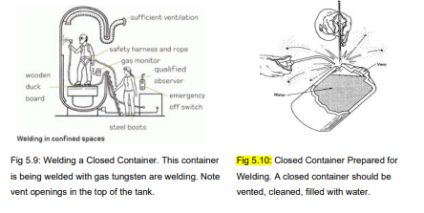
Visuals of welding closed containers:

Slide 24
KT0102 (d) Welding in Confined Areas
Confined spaces are a subset of closed spaces with additional characteristics that pose potential hazards due to limited entry and exit, poor ventilation, or the presence of hazardous substances.
Special Precautions for Confined Spaces:
Welding or cutting in confined areas like storage tanks, underground, or a ship's hull requires specific precautions.
The welding process consumes oxygen, filling the area with potentially lethal gases like carbon monoxide or carbon dioxide.
Welders must ensure constant removal of hazardous gases, smoke, and fumes while pumping in fresh air.
Keep welding gas cylinders and machines outside confined spaces to mitigate the risk in case of a fire.
Never work alone; have someone standby for emergencies.
Consider using a lifeline for quick extraction if the situation demands it.

Slide 25
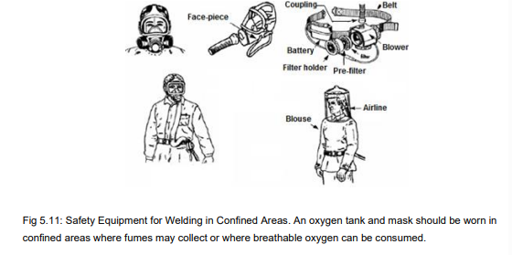

Slide 26
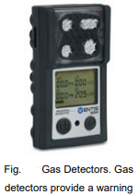
Key notes to avoid toxic fumes when working in closed or confirmed areas.
All welding and cutting should be done in a well-ventilated area to protect against:
Smoke,
Dust, and
Toxic (poisonous) fumes.
Many welding shops are equipped with ventilating systems

Slide 27
Potential Personal Injuries from welding in confined and closed areas
Burns: Most common welding injuries are burns from heat, hot metal, or radiation.
- Welders can avoid burns with proper protective clothing, well-maintained equipment, and adherence to safe work practices.
- Assume everything in the welding area is hot; mark hot objects when leaving to protect others.
Radiation: An energy that can be released from both visible and invisible. It is produced during welding, posing risks to eyes and skin.
Arc flash burn: When the flash of a welding arc reaches unprotected eyes, the resulting injury is called arc flash burn, It can cause symptoms like bloodshot eyes and tearing.
Caution: Do not do any welding for several days if you suffer arc flash burn. If the pain lasts
very long, see a doctor.

Slide 28
High frequency radiation
Most TIG welders, especially those welding various metal types like aluminum, operate at high frequency.
High-frequency (H.F.) can disrupt radio navigation, safety services, computers, and communications equipment.
Only qualified individuals familiar with electronic equipment should perform the installation to prevent interference.
The user is responsible for promptly correcting any interference problems resulting from the installation.
If notified by the FCC about interference, cease using the equipment immediately.
Regularly check and maintain the installation.
Keep high-frequency source doors and panels tightly shut, maintain spark gaps, and use grounding and shielding to minimize interference possibilities.

Slide 29
Safety precautions when using gas cylinders
Compressed gas cylinders contain high-pressure gas and can explode if damaged; handle with care:
Protect cylinders from heat, shocks, physical damage, slag, open flames, sparks, and arcs.
Install cylinders upright, secured to a stationary support or rack, to prevent falling or tipping.
Keep cylinders away from welding or electrical circuits.
Never drape a welding torch over a gas cylinder or let a welding electrode touch any cylinder.
Avoid welding on a pressurized cylinder to prevent explosions.
Use correct cylinders, regulators, hoses, and fittings designed for the application; maintain in good condition.
Turn face away from valve outlet when opening the cylinder valve; avoid standing in front or behind the regulator.
Keep the protective cap in place over the valve, except when in use.
Use proper equipment, procedures, and personnel for lifting, moving, and transporting cylinders.

Slide 30
KT02: Principles of GTAW operation
GTAW (Gas Tungsten Arc Welding) operation is guided by fundamental principles, defining the core aspects of this precise and versatile welding technique.
Topic elements to be covered include:
KT0201: Shielding gas feeding and protection of GTAW electrode
KT0202: Producing electric arc and arc stabilization
KT0203: Melting of the base metal and filler wire feeding
--Assessment Criteria and Weight:
Describe different GTAW shielding gases and their characteristics
Explain how arc stability is achieved when welding GTAW process
Explain how the base metal and filler are melted when welding GTAW process

Slide 31
KT0201: Shielding gas feeding and protection of GTAW electrode
Gas Tungsten Arc Welding (GTAW) is an arc welding process that achieves metal fusion by heating with an arc between a tungsten (non consumable) electrode and the work.
Shielding is obtained from a gas or gas mixture. Both pressure and a filler metal may or may not be used. This process is sometimes called TIG welding, which indicates “tungsten inert gas welding”.
Shielding Gas in GTAW: Argon shields the weld, inert gases like Argon and Helium do not chemically react, providing clear visibility of the arc, and hydrogen may be added for increased travel speeds.

Slide 32
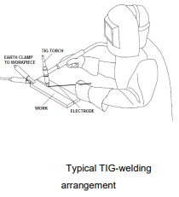
KT0201: Shielding gas feeding and protection of GTAW electrode (p2)
GTAW Temperature and Filler Metal: GTAW reaches temperatures up to 20,000°C, with the torch solely heating the workpiece. Filler metal, if required, can be added manually or via a cold wire feeder.
GTAW is versatile and can be used for welding steel, stainless steel, nickel alloys, titanium, aluminum, copper, brass, bronze, and gold. It excels in joining dissimilar metals, like copper to brass and stainless steel to mild steel.

Slide 33
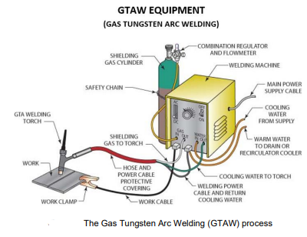

Slide 34
Advantages of GTAW welding:
Concentrated Arc - Permits pinpoint control of heat input to the workpiece resulting in a narrow heat-affected zone.
No Slag - No requirement for flux with this process; therefore, no slag to obscure the welder’s vision of the molten weld pool.
Little Smoke or Fumes - Compared to other arc-welding processes like stick or flux cored welding, few fumes are produced.
Welds more metals and metal alloys than any other arc welding process.
Good for welding thin material.
Good for welding dissimilar metals together.
No Sparks or Spatter - No transfer of metal across the arc. No molten globules of spatter to contend with and no sparks produced if material being welded is free of contaminants.

Slide 35
Disadvantages of GTAW welding:
Slower travel speeds than other processes.
Lower filler metal deposition rates.
Hand-eye coordination is a required skill.
Brighter UV rays than other processes.
Equipment costs can be higher than with other processes.
Concentrations of shielding gas may build up and displace oxygen when welding in confined areas − ventilate the area and/or use local forced ventilation at the arc to remove welding fumes and gases.
If ventilation is poor, wear an approved air-supplied respirator.

Slide 36
Types of GTAW
GTAW can be applied in three formats:
Manual – welder controls the arc length, electrode angles, weld direction and filler metal placement.
Semi-automatic – the GTAW includes a continuous-feed wire spool to feed filler metal to the weld. The welder controls the arc length, electrode angles and the weld direction.
Fully automatic – all the weld variable are controlled by the machine either through physical or computerized machine set-up.
The basic GTAW equipment includes the following:
The welding machine/power source
The torch
Filler metal
Electrode
Shielding gas

Slide 37
The basic GTAW equipment: welding machine/power source
Welding Power Source in GTAW, it is the heart of the welding circuit.
GTAW uses a constant-current (CC) power source.
The power source's volt-ampere characteristic curve influences performance; steeper curves are preferable for manual welding.
Conventional arc welding machines, de-rated by 25%, can be used for GTAW, but specialized GTAW machines are recommended.
GTAW machines have features like high-frequency stability, gas and water valves, enhancing suitability.
Typical GTAW machines operate within a range of 3A - 200A or 5A - 300A at 10V - 35V with a 60% duty cycle.

Slide 38
The basic GTAW equipment: The TIG Torch
Specific torches designed exclusively for gas tungsten arc welding.
Manual torches feature handles, while automatic torches lack handles for clamping in holding brackets.
Basic construction remains consistent across torch types.
Two variants: air-cooled torches for light-duty welding (up to 150A) and water-cooled torches for heavy-duty welding (up to 600A).
Head angle measured between the handle's center-line and the tungsten's center line.
Guns rated by current-carrying capacity, usually at a 100% duty cycle.
Nozzle inside diameter specified in millimeters or numerical representations of 3 mm divisions.

Slide 39
The basic GTAW equipment: Filler metal (Rod)
Not used for welding extremely thin metals; added in most applications.
Filler metal composition should match the base metal.
Filler metal rod size depends on the base metal thickness, influencing welding current.
Manual addition of filler metal is common, but automatic feed can be used.
"Reinforcement" of a weld requires adding filler material to the molten weld pool, typically using a filler rod.
Filler rods are solid wires, available in pre-cut lengths or on reels, made of a compatible alloy with the base metal.
Identification codes stamped on filler rods, ensuring proper selection.
TIG filler rods are distinct from Gas Welding Rods and should be chosen accordingly.

Slide 40
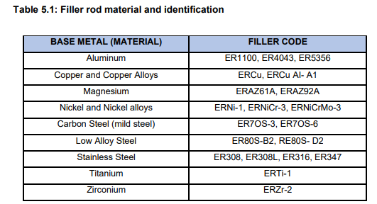

Slide 41
The basic GTAW equipment: Electrode
Primary electrode material for gas tungsten arc welding is tungsten or tungsten alloys.
Tungsten chosen for its exceptionally high melting point (3410ºC).
American Welding Society (AWS) standardizes four classes of tungsten electrodes.
AWS classification and color codes for electrode tips provided in tables.
Tungsten electrodes come in two finishes: standard and ground.
Ground finish offers a smooth, perfectly round electrode, enhancing heat conduction.
Available in various diameters from 0.020 to 0.250in (0.5 to 6.4mm).

Slide 42
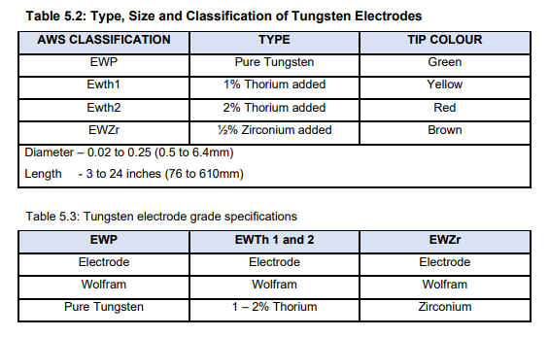

Slide 43
Tungsten Electrodes Overview:
There are Four types of Tungsten Electrodes: EWP (pure tungsten), EWTh1 (1% Thorium), EWTh2 (2% Thorium), EWZr (0.5%-1% Zirconium).
Thorium and zirconium additives enhance electron emission, offering:
Increased current-carrying capacity.
More stable arc.
Improved arc starting.
When installing a new electrode, place the colored tip at the back to prevent arc damage.
Proper collet size is essential for the tungsten used, ensuring a tight assembly for effective heat transfer to the torch body.
EWP (pure tungsten) is economical for less critical or general-purpose work.
EWTh1 (1% thoriated) provides easier arc starting, a stable arc, and higher temperature operation.
EWTh2 (2% thoriated) offers superior arc starting, stability, and increased current capacity.
EWZr (zirconated) electrodes provide longer life and stability, table 5.4 outlines the continuous welding current range for each electrode type based on size.

Slide 44
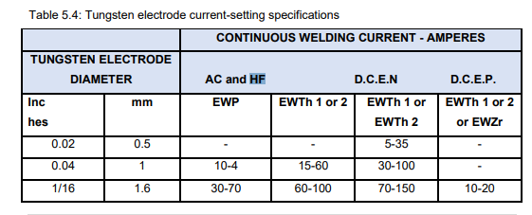
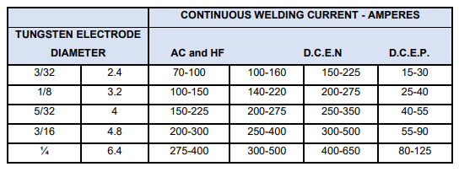

Slide 45
Working with tungsten Electrodes Cautions
Considerations for Electrode Size:
Type of current, and word requirements
Size Selection Examples:
Tungsten Erosion Considerations:
Too much current or too small an electrode causes excessive erosion.
Proper electrode size minimizes erratic wandering of the arc.
Post-Use Assessment:
Electrode Pointing Angle:
Electrode should remain shiny.
Angle relates to welding current and metal thickness (common range: 30-120 degrees).
Refer to welding procedure schedules for required welding current.
Amount of current to be used.
Welder preference and experience influence size selection.
For 100A AC, options include 2.4mm EVVT or pure tungsten, or 3.1mm pure tungsten.
Different sizes needed for DCEN or DCEP.
Larger electrodes or alloyed types may be preferred if overheating or contamination occurs.
Eroded tungsten particles may deposit in the weld metal.
Arc Conditions:
Grind electrode to a point to improve control and direction.
Avoid allowing the electrode to touch molten metal to prevent contamination.
Balled end should not exceed 2 times the electrode diameter.
60 degrees is the most common angle.

Slide 46
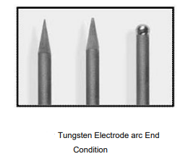
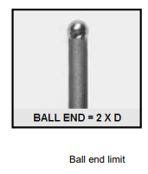
Tungsten Electrode arc End Condition examples:

Slide 47
The basic GTAW equipment: Shielding gas
Gas tungsten arc welding (GTAW) relies on inert gases, with argon and helium as the preferred choices due to cost-effectiveness.
Gas selection is metal-dependent, and the procedure schedule guides the determination of the required gas flow rate.
Consultation with the procedure schedule is essential for accurate shielding gas selection in GTAW.

Slide 48
The basic GTAW equipment: Shielding gas (p2)
Types of Shielding Gases
Most used mixture contains 15% hydrogen, preferred for various applications.
Hydrogen content of 5% preferred for manual welding to achieve cleaner welds.
ARGON:
Commonly used, readily available.
Lighter than argon or air, tends to float away, higher flow rates.
Argon-Hydrogen Mixtures:
Used in special cases (e.g., mechanized welding of light gage stainless steel tubing).
Heavier than helium and air for efficient arc shielding at lower flow rates.
Better for arc welding, operates at lower arc voltage.
HELIUM:
Provides higher voltage and more heat in the arc, allows higher welding speeds.
Can be mixed with argon for optimal shielding gas based on metal and schedule.
Hydrogen addition increases arc voltage and welding speed.
Hydrogen concentration varies based on metal thickness and joint type.
Up to 35% hydrogen used on all thicknesses of stainless steel with certain conditions.
Limited use to stainless steel, nickel-copper, and nickel base alloys due to hydrogen effects.

Slide 49
The basic GTAW equipment: Shielding gas (p3)
Selection of Shielding Gas
There are no strict rules dictate gas choices; argon, helium, or a mix can be successful for most applications.
Argon is generally preferred due to smoother, quieter arcs, easier handling, and lower costs.
Helium is chosen for higher heat penetration in welding thick sections of materials like aluminum or copper.
Argon is essential for manual welding of extremely thin materials.
The final gas selection considers factors like material type, thickness, joint design, welding parameters, and economic and quality requirements.
Gas suppliers often provide guides for selecting the appropriate shielding gas.

Slide 50
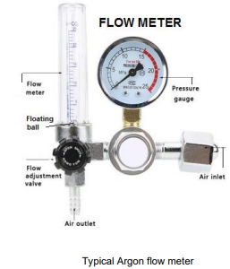
Effect of wind and draft on GTAW processes
Crosswinds or drafts exceeding 1.5 km/h (1 mph) can disrupt shielding gas coverage. Welders must use wind breaks or protective screens to prevent wind or draft interference and enhance shielding gas flow.
GTAW gas regulators and flowmeters
Flow meter typically has a hollow tube with a ball, calibrated in liters per minute.
Adjust the flow meter until the ball aligns with the desired flow rate on the scale.
The regulator controls the flow rate chosen, independent of cylinder pressure.
Flow rate is determined by factors like base metal thickness and welding conditions.

Slide 51
Reasons for excessive consumption of the tungsten electrode
Excessive tungsten consumption is a common issue. Setting the balance control toward the electrode positive (EP) can cause electrode meltdown.
Welders need to set the balance control toward the electrode negative (EN) for better heat distribution.
Amperage too high is another cause; always follow the recommended parameters.
Welders need to always follow the tungsten electrode manufacturer’s recommended
operating parameters for the diameter being used.
Incorrect shielding gas and loose fittings lead to excessive tungsten consumption.
Welders need to use clean argon and ensuring tight fittings before welding, .
Tungsten contamination can occur from touching it to the workpiece; adjust torch angle.
Inadequate shielding gas flow may cause contamination; maintain a proper flow rate.
Contaminated tungsten is a leading cause of an unstable arc; remedy by regrinding the electrode lengthwise.
Welders must grind a taper on the tungsten electrode, using a designated wheel to avoid further contamination.

Slide 52
Assessment Activity
Briefly describe the GTAW welding process in SIX clear steps – referring to keywords: GTAW, fusion, tungsten electrode, arc, shielding, Argon, filler rod, torch, metals, dissimilar metals.
Make a simple line sketch of a basic GTAW welding system – listing the FIVE important parts.
Give SIX disadvantages of TIG welding any other type of welding process?

Slide 53
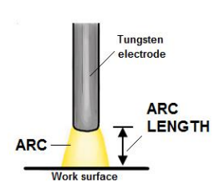
KT0202 Producing electric arc and arc stabilization
The welding arc can be seen as a conductor of gas that transforms electrical energy into heat energy – a cylinder-shaped body of gas which is held together by the heat which is created by the weld process.
Two factors determine the weld deposition (how the welding process allows the fusion of two metals):
The arc length.
Stability of the arc
Arc length has previously been described as the distance between the tip of the tungsten electrode and the work (object to be welded).

Slide 54
Arc stability
With a stable arc - metal transfer is uniform, and the amount of spatter is very small. Arc stability is another important characteristic of arc welding. Arc stability is influenced by parameters such as the following:
Arc power
Metal transfer mode
Frequency of the metal transfer mod
The main effect of low arc stability (unstable arc) – is spatter. This creates material losses, extends cleaning time, and decreases weld bead quality.

Slide 55
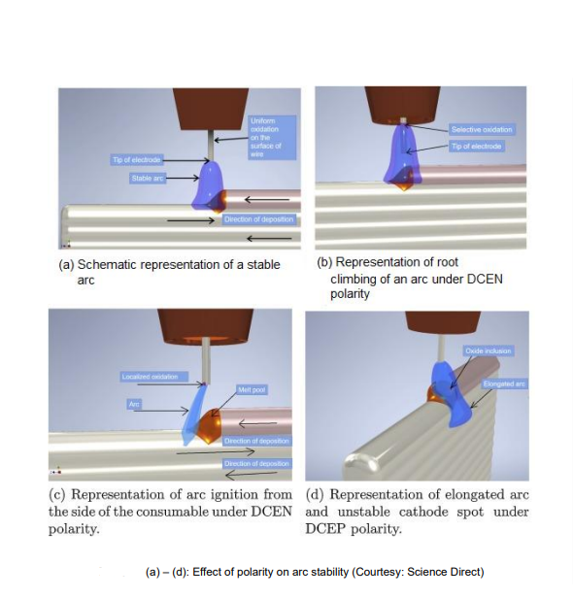
Arc stability (p2)

Slide 56
Arc stability (p3)
The effects of good arc stability:
the shape of all transferred material is constant
the length of the arc is constant, and
there is a low level of spatter or no spatter at all.
If the weld is not performed correctly, there could be an Arc blow (usually experienced with DC current).
It occurs when the welding arc deviates from the shortest path between the electrode and the workpiece, often shifting forward or backward, or occasionally to one side, due to disconnection during welding.
Welders must take note of various arc types, including short arc, globular arc, and spray arc.

Slide 57
Arc stability (p4): Classification of arc types
The American Welding Society (AWS) categorizes arc types into three major classifications, including drop spray or projected spray, rotating spray, and streaming spray, while the International Institute of Welding (IIW) further refines spray arc types into three categories.
Arc stability is therefore measured according to the type of transfer taking place during the GTAW process.

Slide 58
Arc stability (p5): Classification of arc types
Bridging Transfer
In this type, molten metal extends until it touches the weld pool, causing a short circuit that leads to droplet detachment.
Projected Spray (Spray Arc)
Droplets detached from the electrode to the weld pool are smaller than the electrode wire's diameter, resulting in a steady, low-spatter arc mode.
Rotating Spray
Characteristics
Projected spray arc characteristics include steady detachment, low spatter, constant droplet size, and direct droplet transfer.
Arc Modes
Flight Transfer
No contact occurs between the electrode wire and the weld pool in flight transfer.
Molten metal from the electrode rotates, forming a rotating spray arc.
Arc modes are influenced by arc voltage and current levels, allowing changes from short arc to globular arc, projected spray arc, streaming arc, and finally, rotating arc.

Slide 59
Arc stability (p6):unstable arc
Shortening the arc by moving the torch and tungsten electrode closer to the workpiece prevents instability and wandering in both AC and DC applications, avoiding contact with the workpiece.
Dirty base materials and shielding gas can cause instability. Clean thoroughly and use clean, pure argon with a flow rate of 10-20 CFH.
Choose the right size and type of tungsten electrode for the amperage to prevent arc-starting issues in AC and DC welding.
Using a large tungsten rod can cause the arc to rotate.
A too-small tungsten rod may melt and result in an unstable arc. Follow the manufacturer's recommended parameters for each tungsten electrode diameter.
Welders need to Secure the ground clamp, check cables for damage, maintain short and close-together cables, and follow the power source manufacturer's recommendations to address arc-starting issues in TIG welding. A comprehensive approach, combining knowledge, training, and practice, is essential for resolving tungsten electrode and arc troubles.

Slide 60
KT0203 Melting of the base metal and filler wire feeding
GTAW Filler metals
As in all fusion welding, the filler metals used in the GTAW process, must be compatible with the base metal (the workpiece). Welders must select GTAW filler metals compatible with the base metal in rod or wire spool form.
These metals are supplied in rod form for manual welding and on wire spools for continuous, automated welding. They range from 0,020” for very thin base metals up to 4,8 mm for heavier plate.
GTAW filler rods have a controlled chemical composition, often with deoxidizers to prevent oxide contamination.
Avoid using oxy-acetylene rods for GTAW to prevent tungsten electrode contamination.
Keep filler rods clean and never remove them from the shielding gas blanket.

Slide 61
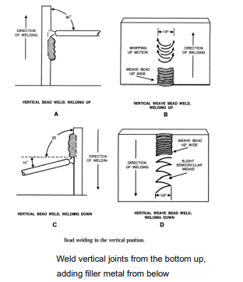
Adding filler metal
Hold the filler rod at a 15-degree angle to the work surface if filler metal is needed.
Point the filler rod into the arc area just inside the shielding gas envelope.
Dip the filler rod into the leading edge of the puddle, avoiding melting in the arc stream.
Adjust in-out rod motion and torch motion for the correct amount of filler metal and a uniform weld bead.
Keep the hot end of the filler rod in the inert gas shield to prevent contamination.
Use straight torch motion for thin metals and a weaving or circular motion for wide joints or thick metal.
Adjust travel speed for good penetration on both sides of the joint.
Add extra filler metal at the end of the weld bead to fill in the small crater.
When welding vertically, move the torch upward and add filler metal from below the torch.
For fillet welds, hold the torch to bisect the angle between joint surfaces.
Use a backup plate for butt joints in thin metals to support the joint and prevent burn through.
Stop welding by lifting the torch away from the workpiece and allow post flow to protect the tungsten electrode.
Adjust post flow time and amount on most GTAW machines.
Turn off the welding machine and close valves to stop gas and water flow when finished.

Slide 62
KT03 GTAW process variables
The Gas Tungsten Arc Welding (GTAW) process involves adjusting various parameters, including arc voltage, current, electrode type, gas selection, travel speed, and more, to achieve precise and efficient welds tailored to specific materials and joint configurations.
After completing this topic, you the learner will be able to demonstrate an understanding of:
KT0301: GTAW process primary variables i.e., arc length, welding current, travel speed and shielding gas.
Criteria by which you will be assessed:
Explain GTAW essential variables

Slide 63
A. Welding Current:
Welding current, representing electron flow, is a critical factor in GTAW, it is categorized as a constant current process due to the dynamic nature of voltage.
Selection of welding current is influenced by tungsten electrode diameter, gas type, and welding polarity.
An increase in welding current leads to grain refinement in the welding metal and reduces the hardness.
An increase in current results in an increase in deposition rate. According to joule’s effect, heat is directly proportional to current and time.
The bead height increases with increase in current (in aluminium welding) while the bead penetration remains constant with increasing current. (Bead width decreases with increase in current)

Slide 64
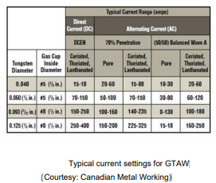

Slide 65
B. Welding Polarity
There are three different polarities which might be used when using GTAW depending on the power supply being used.
The direction that the electron flows is referred to as the polarity. Electron generally flows from a negatively charged body to a positively charged body.
If a direct current power supply is used and the workpiece is connected to the positive terminal is called DCEN. On the other hand, if the parent material is connected to the negative terminal of the direct power supply is called DCEP.
If an alternating current power supply is used the polarity is referred to as AC. Due to the direction of electron movement 70% of the heat in DCEN is directed to the workpiece and 30% of the heat is directed to the electrode and vice versa when DCEP is used.
This results in narrow and deep weld pool in case of DCEN polarity due to high energy in the parent metal. The arc forces the droplets away from the workpiece due to the low rate of electron emission from the negative electrode.
For a DCEP, weld pool is shallow. This method can be used to clean the surface of the workpiece by knocking off oxide films by the positive ions of the shielding gas. DCEP produces rapid heating and degradation of electrode tip because the anode is more heated than cathode.
In case of AC polarity 50% of heat is directed towards the workpiece and the other 50% of the heat is directed to electrode. The AC polarity provides reasonably good penetration of the weld pool and oxide cleaning as shown in Figure.

Slide 66
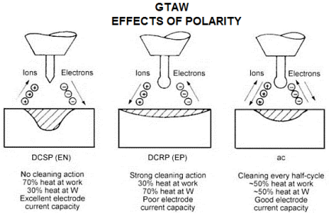
Effects of polarity during GTAW – different weld configurations

Slide 67
C. Welding Speed
Speed of welding is defined as the rate of travel of the electrode along the seam or the rate of travel of the work under the electrode along the seam.
Depth of penetration also gets affected by the welding speed. The depth of penetration increases with increasing welding speed up to the optimum value then starts decreasing with further increase in welding speed for a constant voltage and current conditions.
Weld bead geometry for Aluminum weld - bead width decrease with the increase in welding speed.
Process efficiency and melting efficiency increases with increase in welding speed

Slide 68
D. Welding Voltage
Voltage in welding controls arc length and cone size. Higher voltage results in a longer arc and broader cone, while lower voltage shortens the arc and narrows the cone. Initial high voltage aids arc initiation and provides a wider range of working distances.
Depth of penetration decreases as voltage increases.
In manual GTAW welding, keeping a constant filler feeding rate is essential due to the difficulty of adjusting it during welding, with voltage serving as a controlling variable.
Therefore, GTAW is a constant current (CC) output method, as research indicates that welding voltage has an inverse effect on weld deposit area, leading to a decrease in deposition rate with an increase in welding voltage.
Increased arc voltage increases the arc length which results in wider Bead width

Slide 69
E. Shielding Gas
Helium as a shielding gas reduces the current channel diameter, while Argon increases it, leading to improved electrical conductivity. Helium causes current constriction, resulting in higher peak heat intensity.
CO2 welding yields a higher temperature on the anode surface compared to Helium gas. The higher molecular weight of CO2 leads to increased current constriction near the cathode, resulting in higher plasma temperature.
Adding hydrogen to argon enhances arc plasma melting efficiency, increasing penetration depth and bead width while reducing weldment hardness and impacting mechanical properties.

Slide 70
GTAW process variables in a summary
Welding Current
Influences heat input and bead geometry.
Welding Polarity
Weld Speed
Impacts bead geometry.
Welding Voltage
Shielding Gas
Protects molten metal, filler rod, and HAZ from air contaminations.
Arc temperature near sharp electrode tip
Increases deposition rate and bead height.
Reduces hardness.
Higher current enhances melting efficiency but increases heat loss to the surroundings.
Affects depth of penetration.
DCEN provides deep penetration, DCEP provides shallow penetration.
DCEP results in more tungsten electrode degradation.
Depth of penetration increases up to an optimum value, then decreases with higher welding speed.
Bead width decreases with increased welding speed.
Process and melting efficiency rise with higher welding speed.
Depth of penetration and deposition rate decrease with higher voltage.
High voltage increases arc length, resulting in a wider bead width.
Affects arc plasma characteristics.
CO2 provides the highest arc constriction.
Argon's ignition characteristics are advantageous; often mixed with helium for better ignition.
Adding a small amount of oxygen to He-Ar mix increases penetration depth.
The tip is higher than with a blunt tip.
Arc velocity, current densities, and heat flux decrease with an increase in tip angle.
Current densities and heat flux at the work surface remain unaffected by varying tip angles.

Slide 71
Assessment Activity True or false
Statement | True | False
Arc length is described as the distance between the tip of the tungsten electrode and bottom of the weld puddle?
The arc's heat energy is created by electrical reactions between the Tungsten electrode and the work surface?
Arc stability is influenced by parameters such as metal transfer mode?
“Arc blow” s caused d when the arc stream does not follow the shortest path between the electrode and the workpiece and is deflected forward or backward from the direction of travel or to one side
If the molten metal from the electrode rotates, it is called projected spray

Slide 72
KT04 GTAW process equipment and consumables
The Gas Tungsten Arc Welding (GTAW) process, also known as TIG welding, relies on specialized equipment and consumables such as the power source, tungsten electrode, shielding gas, and filler metal to achieve precise and high-quality welds.
After completing this topic, you the learner will be able to demonstrate an understanding of:
KT0401: GTAW welding torches
KT0402: Parts of GTAW welding torch
Criteria by which you will be assessed:
Explain different types of GTAW torches
Identify GTAW torch components

Slide 73
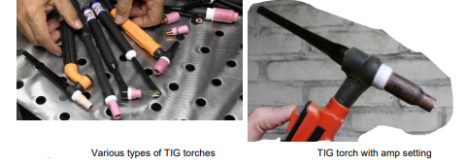
KT0401 GTAW welding torches
These are a crucial tool in the GTAW process, serving as the means to guide the tungsten electrode, control the shielding gas, and facilitate the precise deposition of weld metal. Also referred to as TIG torches.
There are two main categories of these torches:
Air/gas cooled
Water cooled

Slide 74
Air-cooled TIG torches
have only one hose input which is for gas. Therefore, Argon or Helium is shielding your weld puddle from external contaminants while the shielding gas is also cooling down the torch with its airflow.
Disadvantages of AIR-COOLED over WATER-COOLED •
Air-cooled TIG torches are not as effective as water cooled ones.
There are lower amperage ratings on air-cooled torches.
They take longer to cool.
Cannot operate at VERY high temperatures.
Overheat more easily than a water-cooled torch setup

Slide 75
Water Cooled TIG Torches
These have three inputs with three respective hoses. There is the gas input for your shielding gas, a water input line, and a water outflow line. Water cooled TIG torches have an advantage because:
They don’t overheat nearly as fast as air cooled torches.
They can handle very high amperages.
Cooling is FAST - rapid cooling process.
Some torches have neck sections that bend easily to adjust the head angle.
You can get into tight places with this type

Slide 76
Water Cooled TIG Torches (p2)
Disadvantages of using Water Cooler TIG Torches
Welders must have a water cooler system for their welding machine in addition to the torch and water coolers are costly.
Water-cooling is used when welding current exceeds 150 amps
The torch cup in the GTAW process directs shielding gas to the weld area, with cup sizes varying from ¼” (6.35 mm) to ¾” (19 mm) to accommodate different welding conditions and electrode sizes.
It is advisable to choose the smallest cup size that ensures effective shielding for the specific welding task.

Slide 77
KT0402 Parts of GTAW welding torches
The main parts of a GTAW torch include:
Tungsten electrode
Ceramic nozzle or gas cup
Collet • Cap
Handle
Wires in the torch cable carry welding current to the gun. Tubes carry cooling water (if used) to and from the torch.
Water-cooled torches have channels that circulate water in the handle and around other parts of the torch.

Slide 78
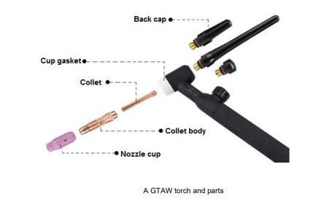
Welding torch nozzles are available in different materials. Normally a ceramic material is used. However, metal nozzles and glass nozzles for visibility, are also available

Slide 79
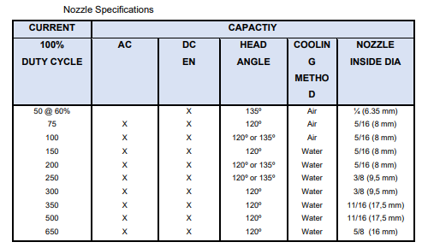

Slide 80
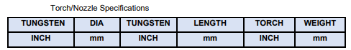
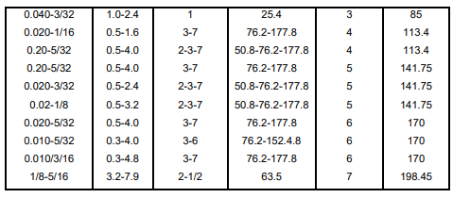

Slide 81
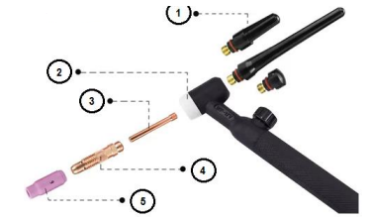
Assessment Activity
Briefly list the names of the following GTAW torch components in the figure below. Write down the number and the name of the part in your answer book.

Slide 82
KT05 GTAW electrodes classification and tip configuration
GTAW electrodes play a crucial role in the welding process, and their classification and tip configuration are key factors influencing welding outcomes. Let's explore the diverse types and configurations of GTAW electrodes.
After completing this topic, you the learner will be able to demonstrate an understanding of:
KT0501 AWS classification of electrodes
KT0502 Consumable and non-consumable GTAW electrodes
GTAW electrode geometry
Criteria by which you will be assessed:
Explain GTAW electrodes in line AWS standard
Describe the difference between a consumable and non-consumable electrode
Explain the GTAW non consumable electrode sharpening geometry

Slide 83
KT0501 AWS classification of electrodes
In gas tungsten arc welding, tungsten and tungsten alloys are commonly used as electrode materials due to their exceptionally high melting point.
The American Welding Society has standardized four classes of tungsten electrodes, each identified by an AWS classification and a corresponding color code on the electrode tip.
These electrodes are available in standard or ground finishes, with ground electrodes offering enhanced heat conduction.
Diameters for tungsten electrodes range from 0.5 mm to 6.4 mm.

Slide 84
KT0502 Consumable and non-consumable GTAW electrodes
In gas tungsten arc welding, there are consumable and non-consumable electrodes. The four main types of electrodes include EWP (pure tungsten), EWTh1 (1% Thorium), EWTh2 (2% Thorium), and EWZr (0.5%-1% Zirconium).
EWTh1 (1% thoriated tungsten): Facilitates easier arc starting, provides a more stable arc, and can operate at slightly higher temperatures.
EWTh2 (2% thoriated tungsten): Offers improved arc starting, greater stability, and a higher current-carrying capacity.
EWZr (zirconated tungsten): Provides longer life and stable operation.
Table 5.x provides the continuous welding current range for each type of electrode, correlated with electrode size.
The inclusion of thorium and zirconium enhances electron emission, leading to increased current-carrying capacity, a more stable arc, and improved arc starting.

Slide 85
Tungsten electrode installation:
Place the color tip of the tungsten electrode at the back end of the torch during installation to prevent damage from the arc.
Ensure the collet is the appropriate size for the tungsten electrode.
Tighten the entire assembly to facilitate heat transfer to the torch body for effective cooling.
EWP or pure tungsten electrodes are cost-effective and suitable for less critical or general-purpose welding on various metals.

Slide 86
Assessment Activity
Give FOUR reasons for the addition of Thorium and Zirconium to the composition of a Tungsten electrode

Slide 87
KT0503 GTAW electrode geometry
Electrode Tip Geometry:
The arc temperature near the electrode tip is highest for a sharp tip and decreases with an increase in tip angle.
The electrode tip angle has no significant effect on the arc temperature just above the workpiece surface.
Arc velocity decreases with an increase in tip angle, and the current density shows an inverse relationship with the tip angle.
Current density at the cathode decreases with an increase in tip angle due to lower electrical potential in the arc.
Heat flux due to conduction and convection is more sensitive to electrode tip angle and decreases with an increase in tip angle, while the heat flux due to electronic contribution remains unchanged.

Slide 88
Guidelines for tungsten electrodes:
Tungsten, a rare metallic element, used for non-consumable gas tungsten arc welding (GTAW) electrodes due to its high hardness and temperature resistance.
Electrodes come in various sizes and compositions, including pure tungsten or tungsten alloys.
Selection depends on factors like base material, thickness, and welding current type (AC or DC).
The choice of end preparation (balled, pointed, or truncated) is crucial for optimal results and contamination prevention.
Electrodes are color-coded for easy identification.

Slide 89
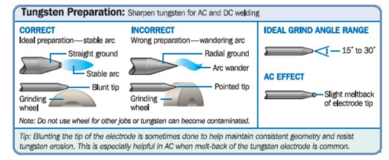
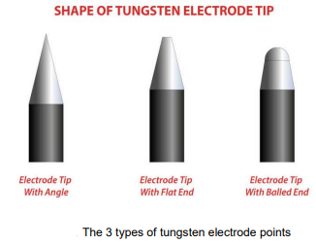
After selecting a type of electrode, the next step is to select an end preparation. The three choices are balled, pointed, and truncated.
Tungsten preparation

Slide 90
Balled tip
A balled tip generally is used on pure tungsten and zirconated electrodes.
Use with the AC process on sine-wave and conventional square-wave GTAW machines.
Method: Simply apply the AC amperage recommended for a given electrode diameter, and a ball will form on the end of the electrode.
The diameter of the balled end should not exceed 1.5 times the diameter of the electrode (for example, a 3 mm electrode should form a 4,5 mm.-diameter end). A larger sphere at the tip of the electrode can reduce arc stability. It also can fall off and contaminate the weld.

Slide 91
Pointed tip
A pointed and/or truncated tip (for pure tungsten, ceriated, lanthanated, and thoriated types) should be used for inverter AC and DC welding processes.
To grind the tungsten properly, use a grinding wheel specially designated for tungsten grinding (to prevent contamination) and one that is made of Borazon or diamond (to resist tungsten's hardness).
Note: If you are grinding thoriated tungsten, make sure you:
Control and collect the dust
Have an adequate ventilation system at the grinding station
Follow the manufacturer's warnings, instructions, and MSDS.

Slide 92
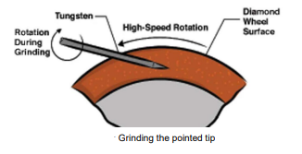
Pointed tip (p2)
Grind the tungsten straight on the wheel to ensure grind marks run along the electrode, reducing ridges that may lead to arc wandering or weld puddle contamination.
Taper the tungsten to a length no more than 2.5 times the electrode diameter for improved arc starting and focused welding performance.
For low-current welding on thin material (0.127 mm to 1 mm), grind the tungsten to a point to facilitate a focused arc and prevent distortion in materials like aluminum.
Avoid using pointed tungsten for higher-current applications, as it can lead to tip blow-off and weld puddle contamination.

Slide 93
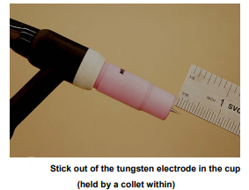
Truncated tip
For higher-current applications, grind the tungsten to a truncated tip by initially creating a taper and then grinding a flat land of 0.254 mm to 0.762 mm on the end.
This flat land prevents the tungsten from being transferred across the arc.
The tungsten electrode is sharpened to a pencil point, with sanding scratches directed toward the tip.
It is held with a collet and typically positioned with a 1/8- to 3/16-inch "stick out" (3.1 mm to 4.8 mm in metric measurements).

Slide 94

The End

